Slide 1
Python Lists and Looping
January 2026

Slide 2
Lists

Slide 3
Lists: Python’s Built-In Collection Type
• A Python list is a built-in container that holds an ordered sequence of items, and list literals are written using square brackets with items separated by commas.
◦ Example: ['red', 'blue', 'green']
◦ Lists can store strings, numbers, or mixed types
◦ Last element: index len(list) - 1

Slide 4
List behave like Strings
• Lists behave like strings in several useful ways, including supporting the len() function and using square brackets with an index to access a specific element.
◦ len(list) returns the number of elements
◦ Indexing uses list[index]
• List indexing starts at zero, meaning the first element is at index 0, the second element is at index 1, and so on as you move right.
◦ First element: index 0
◦ Last element: index len(list) - 1

Slide 5
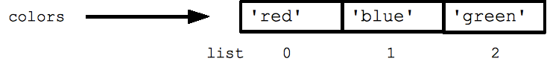
Code Example: Creating a list, indexing, and using len()
colors = ['red', 'blue', 'green']
print(colors[0]) ## red
print(colors[2]) ## green
print(len(colors)) ## 3

Slide 6
Assignment Does Not Copy a List
• Using the equals sign to assign one list variable to another does not create a separate copy, so both variables point to the same list in memory.
◦ Changing one name changes the shared list
◦ This is sometimes called aliasing

Slide 7
Both aliases are edited when you edit the list
• Because both variables refer to the same underlying list, later edits like append() or remove() will be visible through either variable name.
◦ This can be surprising during debugging
• When you truly need an independent list, you must explicitly create a copy using a list-copying technique rather than relying on simple assignment.
◦ Examples include slicing or copy methods

Slide 8
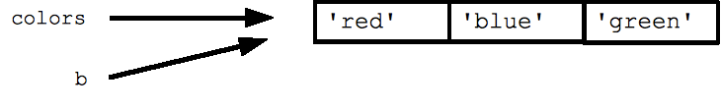
Code Example: Assigning a second variable to the same list
b = colors ## Does not copy the list

Slide 9
How to do an actual copy*
original = [1, 2, 3]
new_list = original.copy() ## uses copy function
new_list2 = original[:] ## uses slice
new_list3 = list(original) ## uses list constructor
* These are “shallow copies”: if the list is nested, it does not copy the inner lists.

Slide 10
Empty Lists and Combining Lists with +
• An empty list is written as an empty pair of brackets, and it is commonly used as a starting point when you plan to build up a list over time.
◦ Empty list literal: []
• The plus operator can combine two lists by creating a new list that contains the elements of the left list followed by the elements of the right list.
◦ [1, 2] + [3, 4] becomes [1, 2, 3, 4]
• List concatenation with + is similar to string concatenation, but it operates on whole elements rather than characters and preserves the order of both inputs.

Slide 11
Looping: for/in

Slide 12
for and in: Looping Through Every Element
• A for loop written as for var in list is the standard Python way to visit each element in a list without manually tracking index numbers.
◦ Pattern: for item in collection:
• Inside the loop, the loop variable holds one element at a time, which makes it easy to read values, calculate totals, or build new results.
◦ Common tasks: summing, filtering, printing
• You should not add or remove elements from the list you are iterating over, because changing the list during iteration can produce confusing or incorrect behavior.
◦ Instead, build a new list or loop over a copy

Slide 13
Code Example: Summing numbers with for/in
squares = [1, 4, 9, 16]
sum = 0
for num in squares:
sum += num
print(sum) ## 30
+= is shorthand for sum = sum + num
e.g. if you have sum += 1, that means sum = sum + 1

Slide 14
Choosing Clear Loop Variable Names
• When you know what kind of value a list contains, choose loop variable names that reflect that meaning, because descriptive names help you understand code without extra type syntax.
◦ Examples: num, name, url
• Python does not require explicit types in everyday code, so names become an important clue that explains what each value represents and how it should be used.
• You may later see type hints in Python, which allow you to annotate function inputs and outputs for tools like IDEs and static analysis tools like linters, but Python does not enforce them at runtime.
◦ Not used to execute the program

Slide 15
in as a Membership Test (True/False)
• The in keyword can be used outside a loop to test membership, where value in collection evaluates to True if the value appears in the collection.
◦ Result is a Boolean: True or False
• This membership test works on lists and other collections, and it is often used in an if statement to run code only when an item exists.
◦ Pattern: if item in items:
• It is useful to memorize for/in syntax because it is the idiomatic Python approach, and it often replaces manual index-based iteration habits from other languages.

Slide 16
Code Example: Testing membership with in
list = ['larry', 'curly', 'moe']
if 'curly' in list:
print('yay') ## yay

Slide 17
Using for/in with Strings
• A string can be iterated with for/in just like a list, because Python lets you treat a string as a sequence of its individual characters.
◦ Pattern: for ch in s:
print(ch)
• When you loop through a string, each iteration gives you a single-character string, which is useful for tasks like counting letters or validating characters.
◦ Each ch is a one-character value
• Using for/in on strings keeps the code simple and readable, and it avoids needing to manually compute indexes unless you truly require numeric positions.

Slide 18
Range

Slide 19
range(): Generating Counting Numbers for Loops
• The range(n) function produces a sequence of numbers starting at 0 and ending at n minus 1, which is a common pattern for repeated actions.
◦ range(5) yields 0, 1, 2, 3, 4
• The form range(a, b) starts at a and counts upward to b minus 1, which supports loops that begin at a non-zero starting value.
◦ range(3, 6) yields 3, 4, 5
• Combining for with range() creates a traditional numeric loop, where the loop variable is an integer counter rather than an element from a list.
◦ Pattern: for i in range(...):

Slide 20
Code Example: Printing numbers with range()
## print the numbers from 0 through 99
for i in range(100):
print(i)

Slide 21
Performance Note: xrange() vs range()
• In older Python versions, xrange() was a variant designed to avoid building a full list of numbers in memory, which could matter in performance-sensitive loops.
◦ Relevant historically in Python 2
• In Python 3, range() already has the efficient behavior, so you can typically use range() everywhere and not worry about an xrange() alternative.
◦ Python 3: range() is efficient
• Even when performance matters, it is better to understand the behavior conceptually—range supplies a sequence for looping—rather than assuming it is a normal list.

Slide 22
For/in and Range Exercises

Slide 23
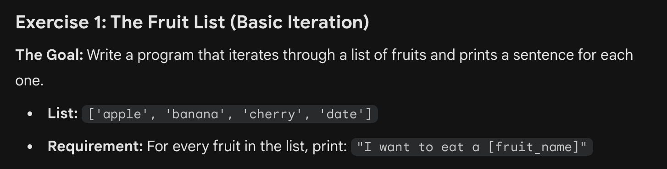
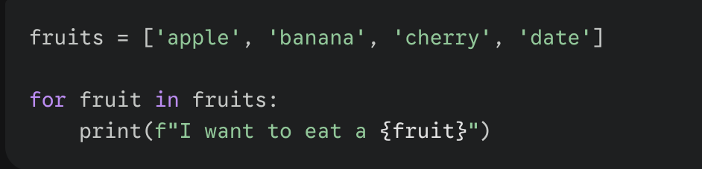
Exercise 1

Slide 24
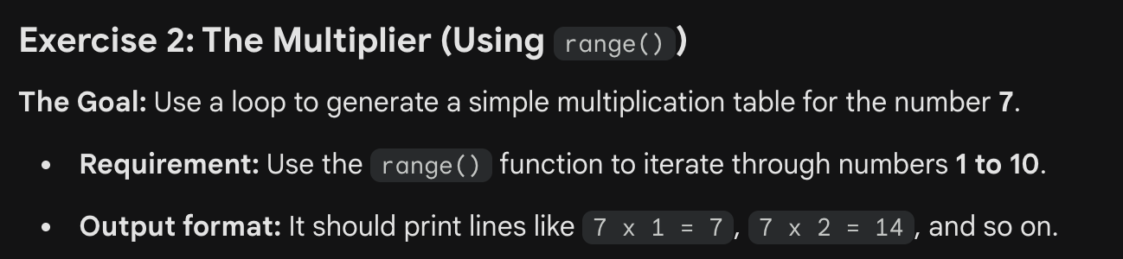
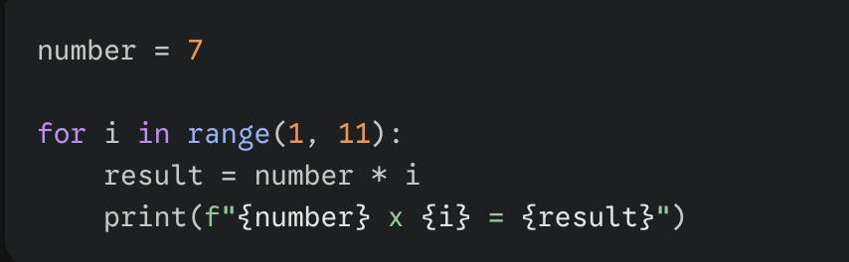
Exercise 2

Slide 25
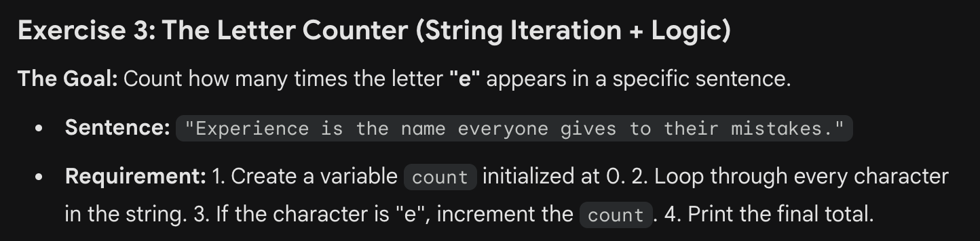
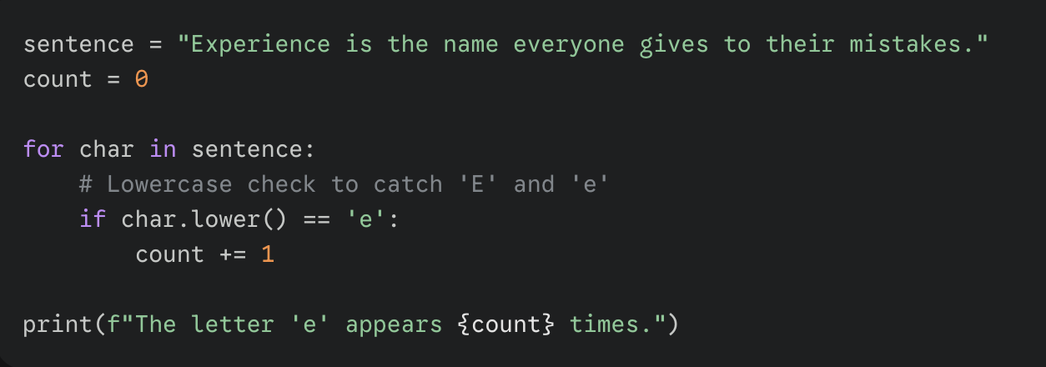
Exercise 3

Slide 26
while Loops

Slide 27
while Loops, break, and continue
• Python includes a while loop for cases where you need total control over loop conditions, and it repeats as long as its condition remains True.
◦ Pattern: while condition:
• The break statement exits the innermost loop immediately, while continue skips the rest of the current iteration and proceeds to the next cycle.
◦ Both behave similarly to C++ and Java
• Although for/in handles most element-by-element list processing, while loops are useful when you need to jump by steps, stop early, or manage indexes directly.

Slide 28
Code Example: Accessing every 3rd element with a while loop
## Access every 3rd element in a list
i = 0
while i < len(a):
print(a[i])
i = i + 3

Slide 29
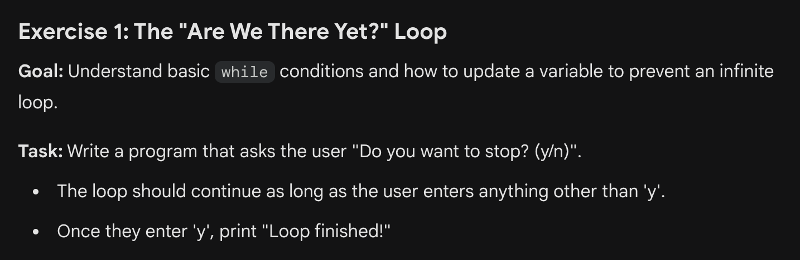
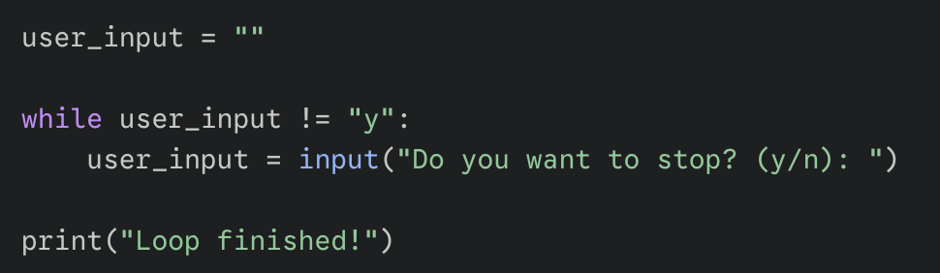
Use input(“text”) to get user’s input.

Slide 30
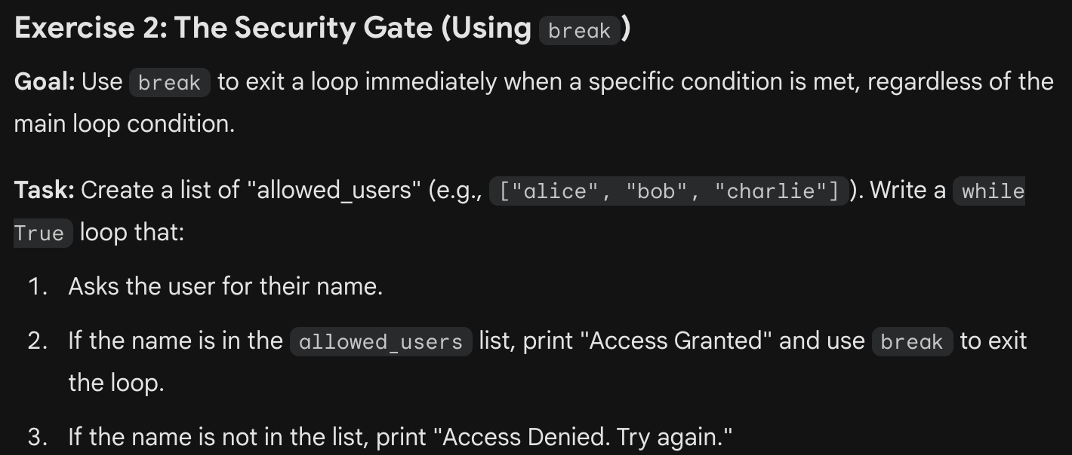
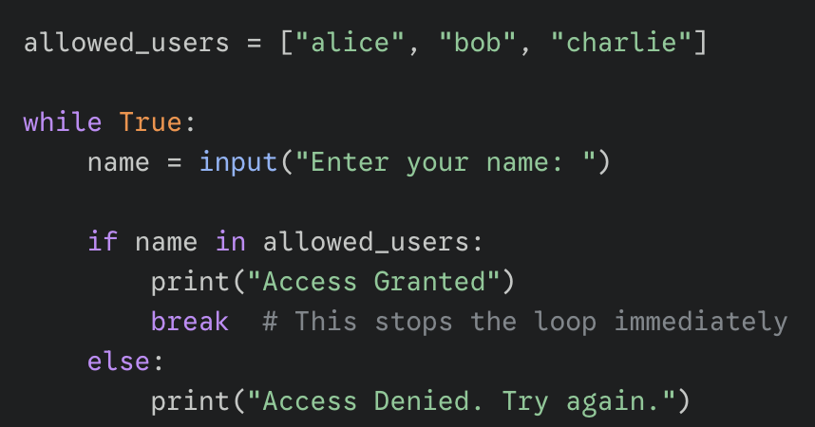

Slide 31
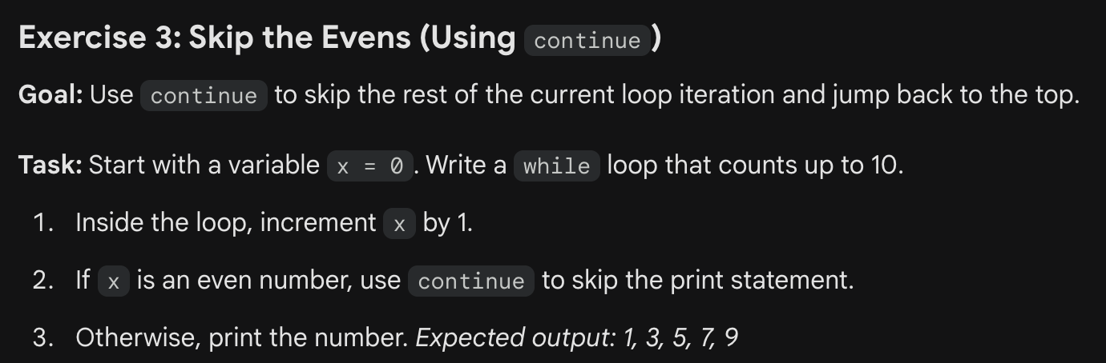
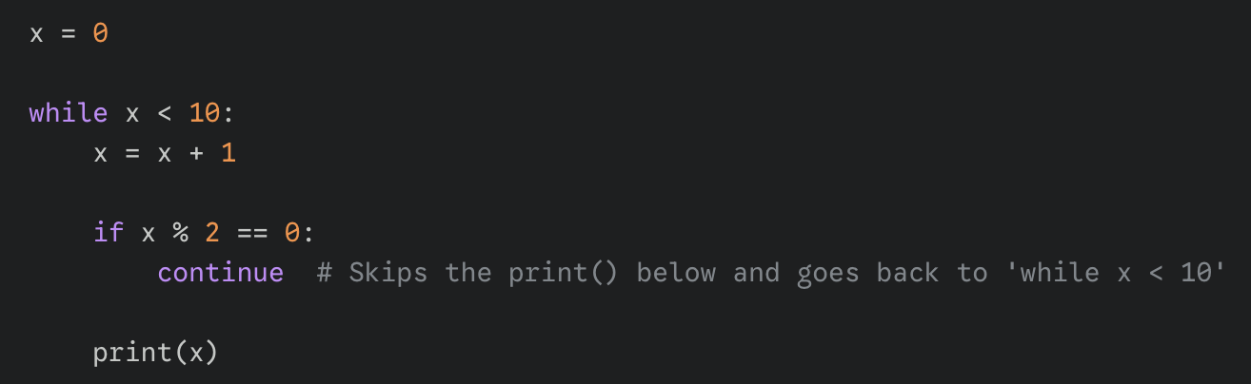

Slide 32
Session 2 on Lists

Slide 33
List methods

Slide 34
Common List Methods and How They Behave
List methods like append(), insert(), extend(), and remove() change the list object in place, meaning the original list is modified instead of producing a new list.
list.append(elem) -- adds a single element to the end of the list. Common error: does not return the new list, just modifies the original.
list.insert(index, elem) -- inserts the element at the given index, shifting elements to the right.
list.extend(list2) adds the elements in list2 to the end of the list. Using + or += on a list is similar to using extend().
list.remove(elem) -- searches for the first instance of the given element and removes it (throws ValueError if not present)
It helps to notice that len() is a function that takes a list argument, while append() and other operations are methods called with dot notation on the list itself: len(list) vs list.append(x)

Slide 35
Search and Retrieval Methods
• Some methods are designed for searching and retrieval, such as index() which returns a position, and pop() which removes and returns an element at an index.
list.index(elem) -- searches for the given element from the start of the list and returns its index. Throws a ValueError if the element does not appear (use "in" to check without a ValueError).
The index() and remove() methods raise a ValueError if the element does not exist, so using in first can prevent errors when presence is uncertain.
Use: if elem in items:
list.pop(index) -- removes and returns the element at the given index. Returns the rightmost element if index is omitted (roughly the opposite of append()).

Slide 36
Sort and Reverse Methods
Methods like sort() and reverse() also modify the list in place. A separate sorted() function is often preferred for sorting behavior (will learn later).
◦ In-place: list.sort()
◦ New list: sorted(list)
list.sort() -- sorts the list in place (does not return it). (The sorted() function shown in future session is preferred.)
list.reverse() -- reverses the list in place (does not return it)

Slide 37
Code Example: Demonstrating list methods
list = ['larry', 'curly', 'moe']
list.append('shemp') ## append elem at end
list.insert(0, 'xxx') ## insert elem at index 0
list.extend(['yyy', 'zzz']) ## add list of elems at end
print(list) ## ['xxx', 'larry', 'curly', 'moe', 'shemp', 'yyy', 'zzz']
print(list.index('curly')) ## 2
list.remove('curly') ## search and remove that element
list.pop(1) ## removes and returns 'larry'
print(list) ## ['xxx', 'moe', 'shemp', 'yyy', 'zzz']

Slide 38
Common Error: Methods Modify the List and Return None
• Many list methods do not return the modified list, so printing the result of append() or sort() will show None even though the list itself changed.
◦ This surprises beginners frequently
• The reliable pattern is to call the method on its own line to perform the modification, and then inspect the list variable afterward to see the updated contents.
◦ Call method first, print later
• This in-place behavior is efficient because it avoids creating unnecessary new lists, but it requires you to remember that the method call is an action, not a value.

Slide 39
Code Example: append() returns None
list = [1, 2, 3]
print(list.append(4)) ## NO, does not work, append() returns None
## Correct pattern:
list.append(4)
print(list) ## [1, 2, 3, 4]

Slide 40
List Buildup

Slide 41
Building a List Gradually
• A common and practical workflow is to start with an empty list and then add elements one at a time, which is especially useful when processing input or computing results.
◦ Start: my_list = []
• Using append() adds one element at the end, while extend() adds many elements from another list, so you can choose the method that matches your data source.
◦ append(single_item)
◦ extend(list_of_items)
• This build-up pattern works well with for loops, where each iteration computes a new item and appends it, keeping code clear and avoiding complicated pre-sizing logic.

Slide 42
Code Example: Starting with [] and appending elements
list = [] ## Start as the empty list
list.append('a') ## Use append() to add elements
list.append('b')

Slide 43
List Slices: Extracting and Replacing Parts of a List
• List slicing uses the same start-and-stop style as string slicing, where list[start:stop] returns a new list containing elements from start up to but not including stop.
◦ Stop index is not included
• Negative indexes in slices count from the end, so a slice like list[1:-1] is a convenient way to get the middle portion while excluding the first and last elements.
◦ Useful for trimming boundaries
• Slices can also be assigned to, allowing you to replace a section of a list with new values, which can shrink or grow the list depending on what you assign.
◦ Slice assignment modifies the original list

Slide 44
Code Example: Slicing and slice assignment
list = ['a', 'b', 'c', 'd']
print(list[1:-1]) ## ['b', 'c']
list[0:2] = 'z' ## replace ['a', 'b'] with ['z']
print(list) ## ['z', 'c', 'd']

Slide 45
Mutability of Lists vs. Strings

Slide 46
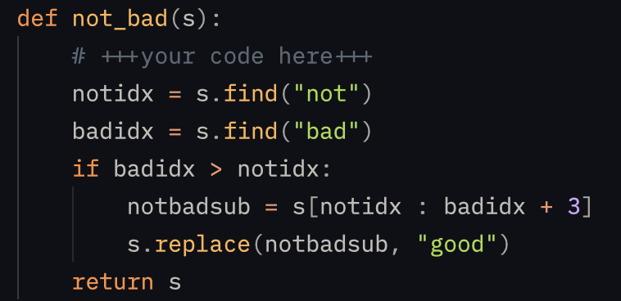

What’s wrong with this code?
Strings are immutable.

Slide 47
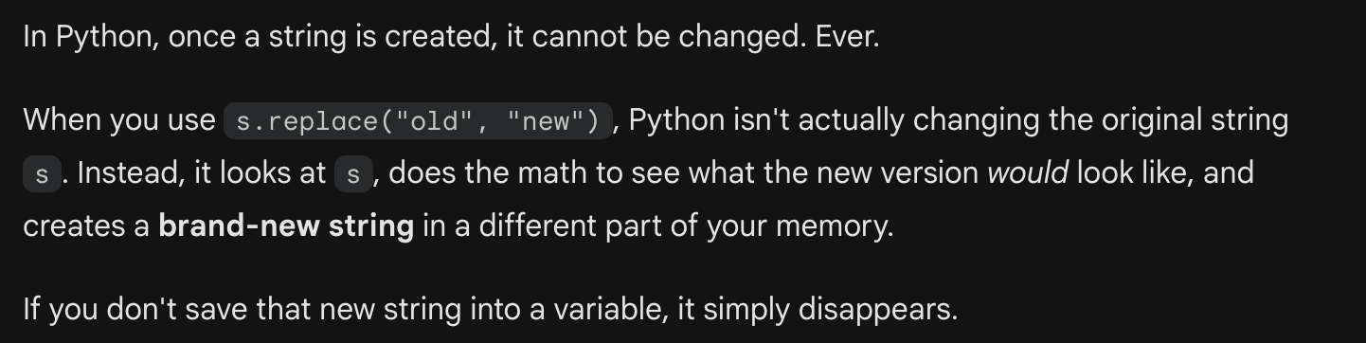
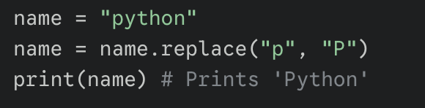
Strings are Immutable

Slide 48
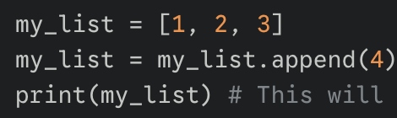
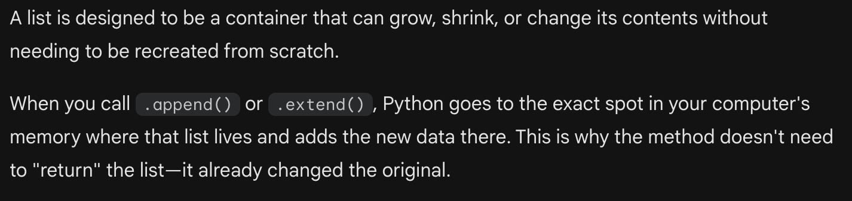
What’s wrong with this code?
Why?
Lists are Mutable.

Slide 49
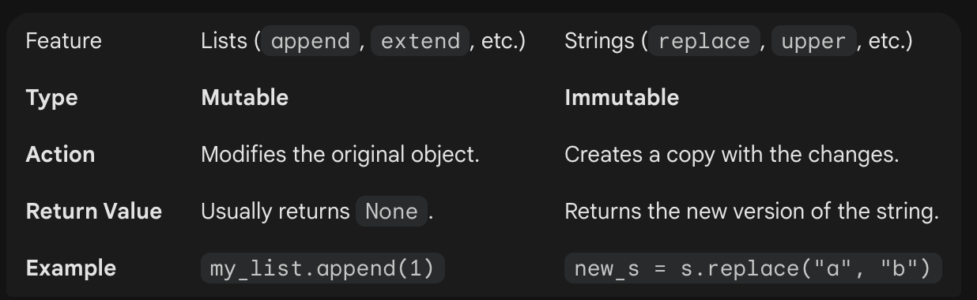
Recap: Mutability of Lists versus Strings

Slide 50
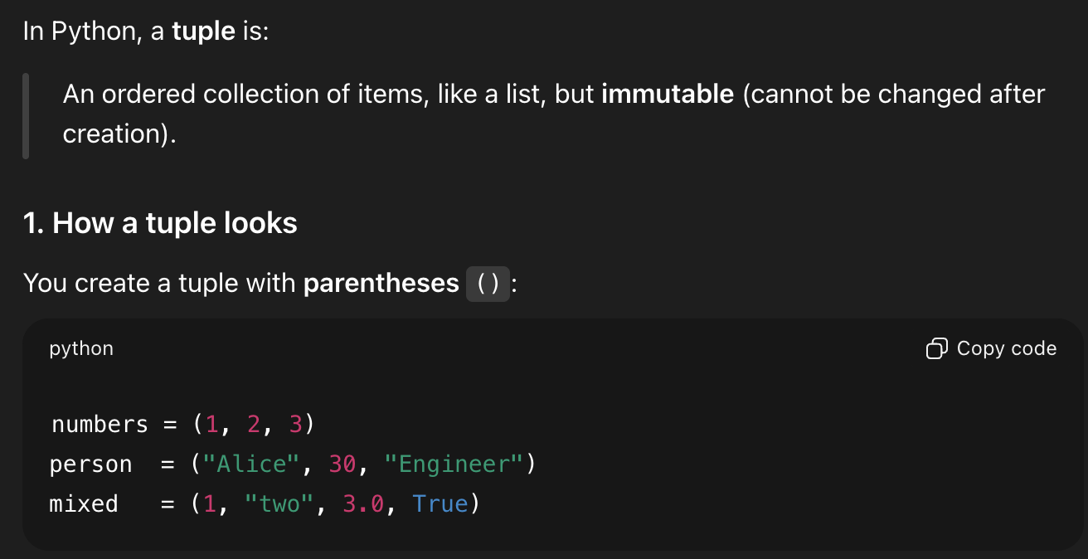
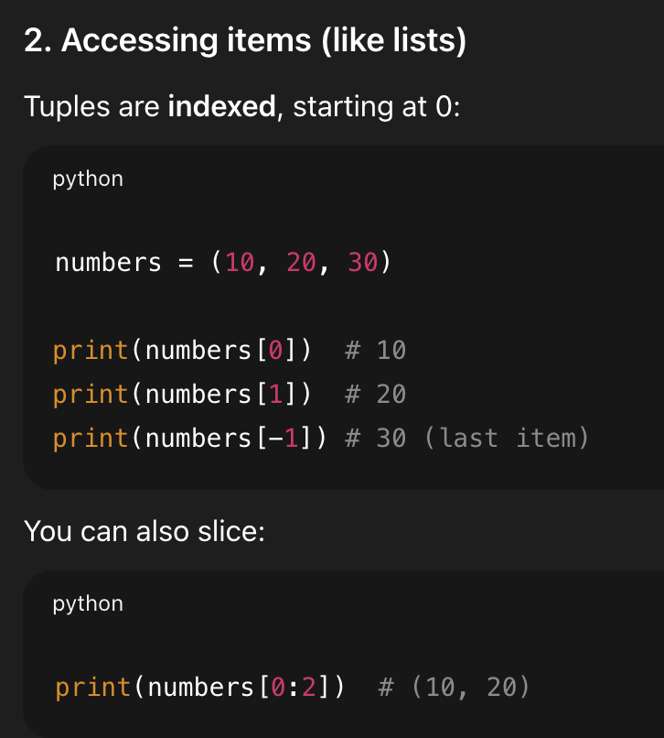
What is a tuple?

Slide 51
List Exercises

Slide 52
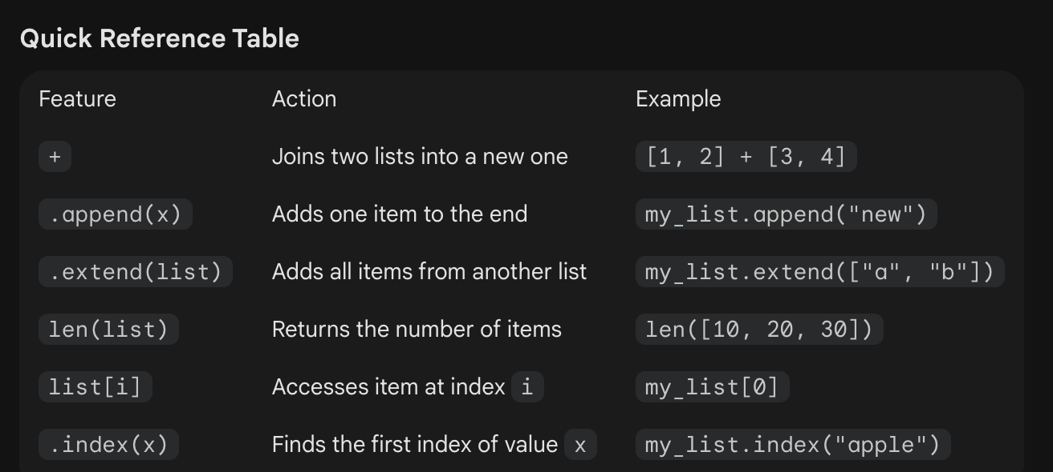

Slide 53
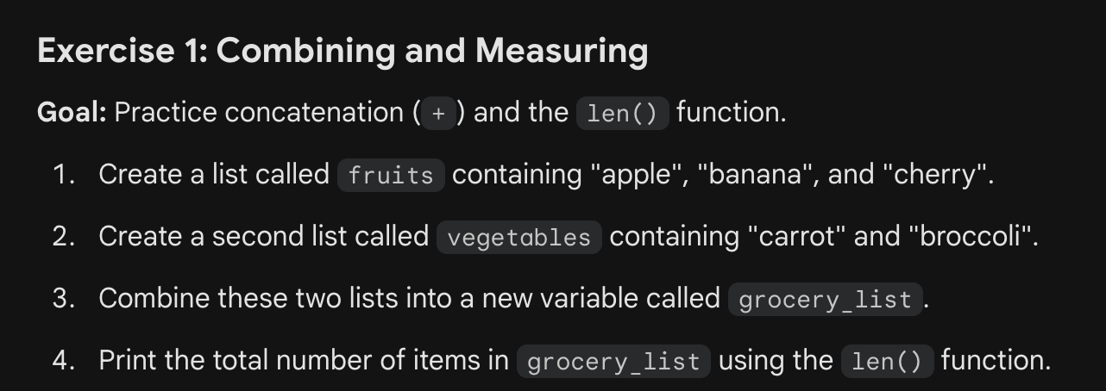
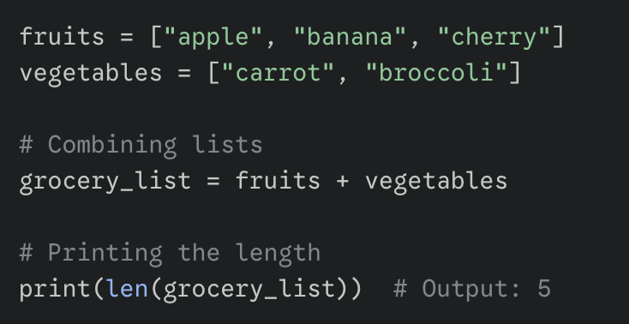

Slide 54
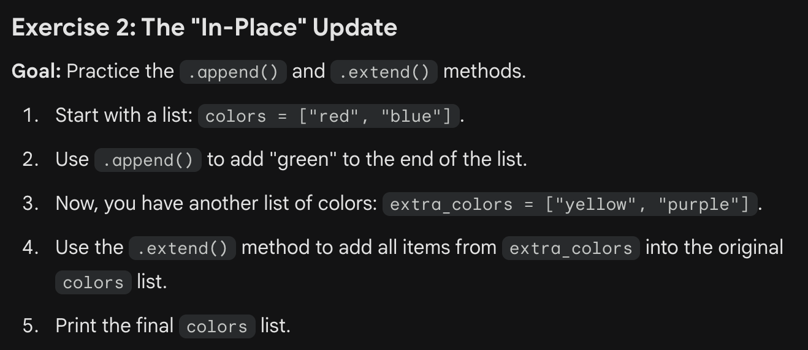
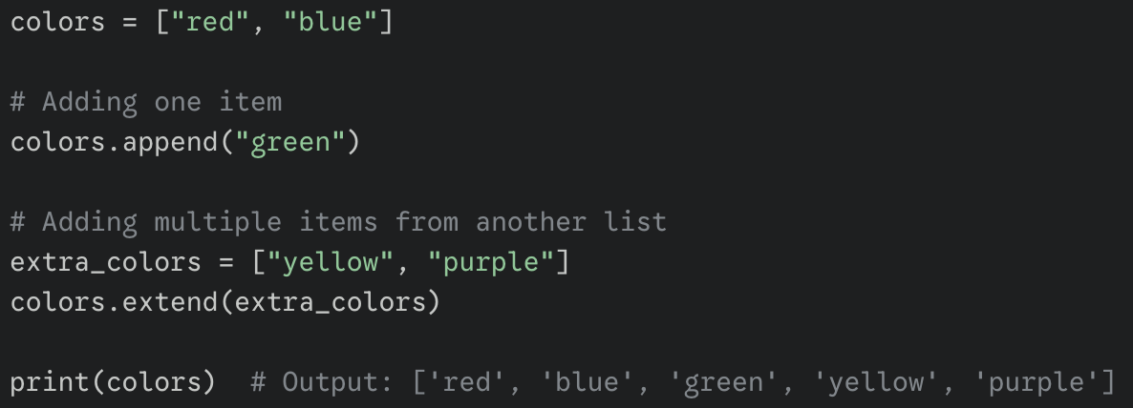

Slide 55
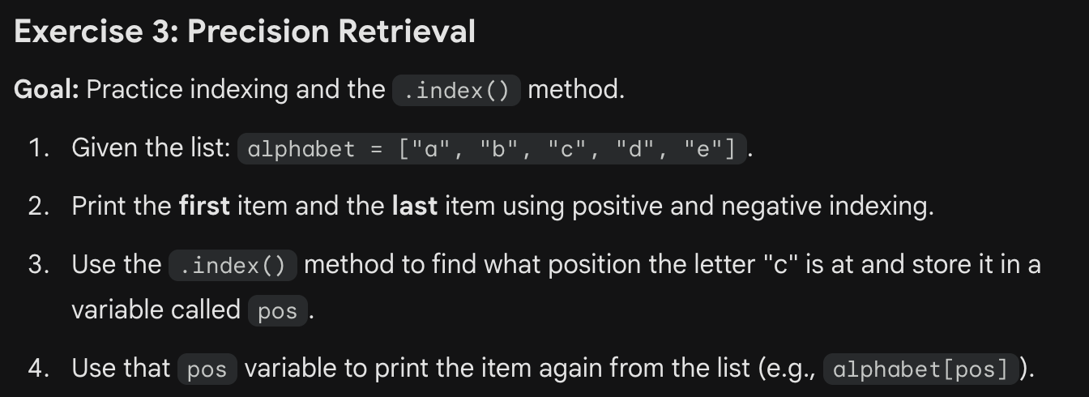
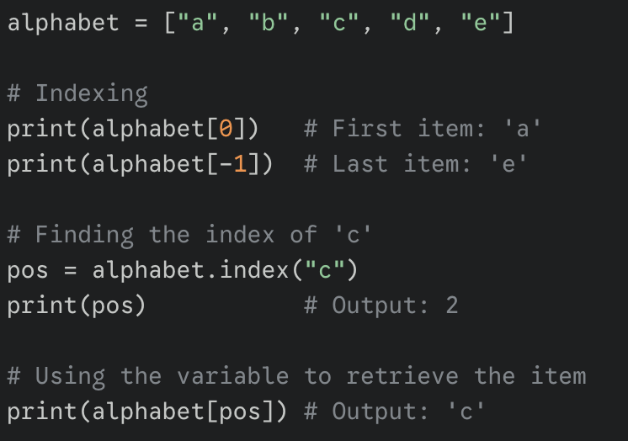

Slide 56
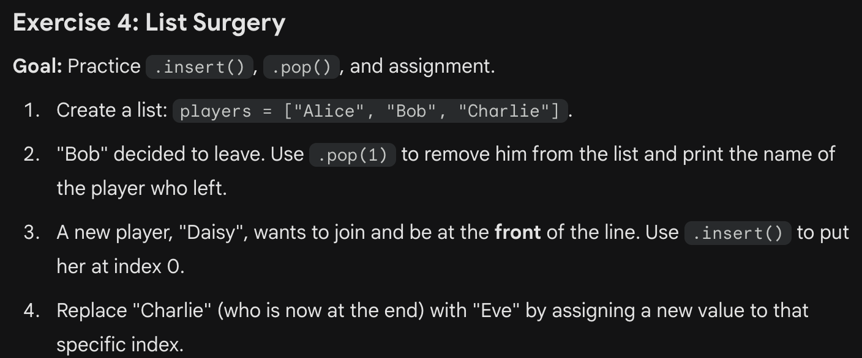
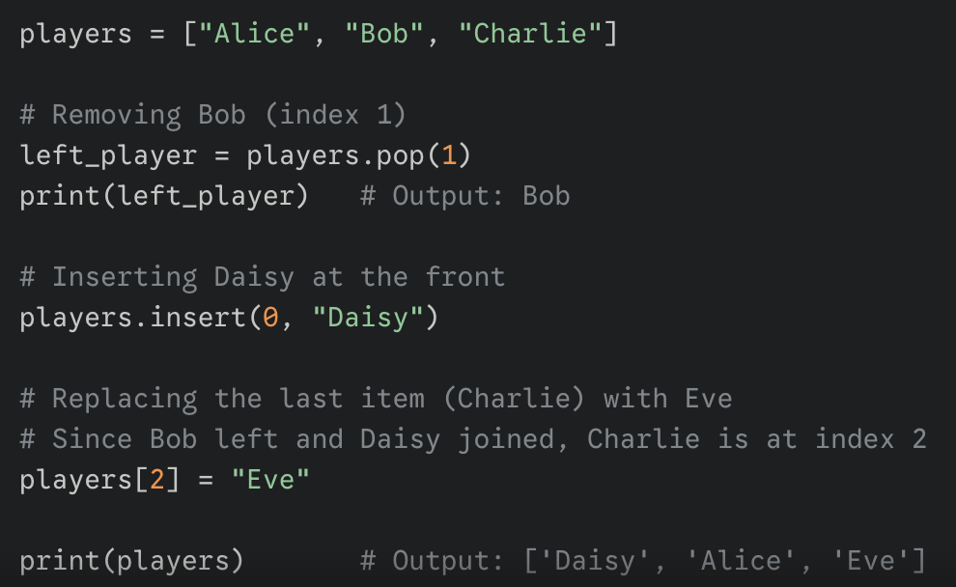

Slide 57
Coding Practice with lists
Solve problem match_ends in list1.py
len(list) returns the number of elements
Solve problem remove_adjacent in list2.py
Build a list method append() adds one element at the end,
Remove elements from list method list.remove(elem) -- searches for the first instance of the given element and removes it (throws ValueError if not present)

Slide 58
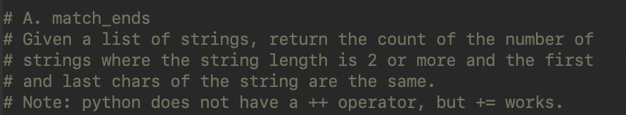
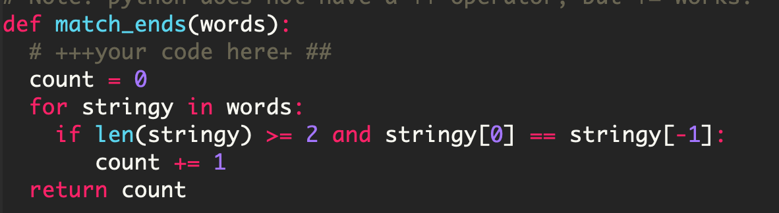
match_ends
Initialize count to zero.
Loop through each string in the list:
If string length is 2 or more, and
the first and last characters of string are equal
increment count by 1

Slide 59
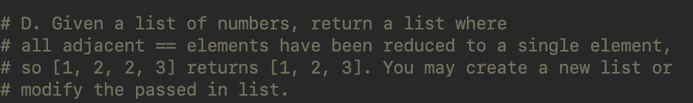
remove_adjacent: Pseudo-code
Initialize a new list.
Loop through each item in old list:
if item is not already in the new list
add the item to the new list
Initialize new list
Loop through each item in old list:
If new list is empty or
item is not equal to the last element in the new list
add the item to the new list

Slide 60
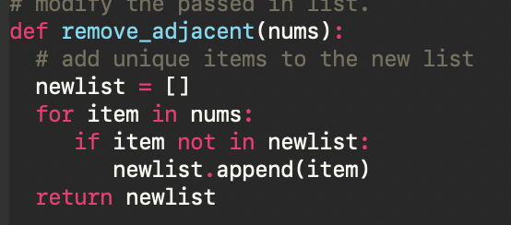
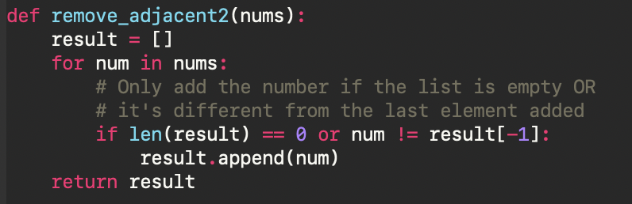
remove_adjacent: Solution
Which solution is more efficient?

Slide 61
Thank you

